Slide 1
A complete guide to programming in c++
Chapter 6 - Control Flow

Slide 2
CHAPTER 6 - CONTROL FLOW
This chapter introduces the statements needed to control the flow of aprogram.
These are
loops with while,do-while, and for
selections with if-else,switch, and the conditional operator
jumps with goto,continue, and break.

Slide 3
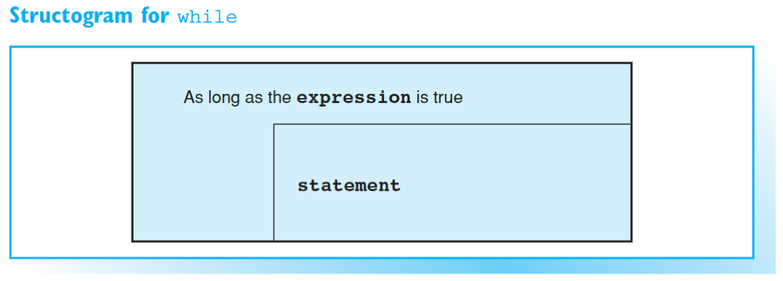

The while statement
Loops are used to perform a set of instructions repeatedly. The set of instructions to be iterated is called the loop body. C++ offers three language elements to formulate iteration statements: while, do-while, and for. The number of times a loop is repeated is defined by a controlling expression. In the case of while and for statements this expression is verified before the loop body is executed, whereas a do-while loop is performed once before testing.
The while statement takes the following format:

Slide 4
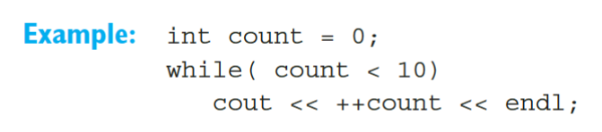
THE WHILE STATEMENT
When entering the loop, the controlling expression is verified, i.e. the expression is evaluated. If this value is true, the loop body is then executed before the controlling expression is evaluated once more.
If the controlling expression is false, i.e. expression evaluates to false, the program goes on to execute the statement following the while loop.
It is common practice to place the loop body in a new line of the source code and to indent the statement to improve the readability of the program.
As this example illustrates, the controlling expression is normally a boolean expression. However, the controlling expression might be any expression that can be converted to the bool type including any arithmetic expressions. As we already learned from the section on boolean operators, the value 0 converts to false and all other values convert to true.

Slide 5
Building Blocks
If you need to repeat more than one statement in a program loop, you must place the statements in a block marked by parentheses { }. A block is syntactically equivalent to a statement, so you can use a block wherever the syntax requires a statement.
EXAMPLE
The EXAMPLE calculates the average of a sequence of integers input via the keyboard. Since the loops contains two statements, the statements must be placed in a block. The controlling expression cin >> x is true provided the user inputs an integer. The result of converting the expression cin >> x to a bool type will be true for any valid input and false in any other case. Invalid input, if the user types a letter instead of an integer, for example, terminates the loop and executes the next statement.

Slide 6
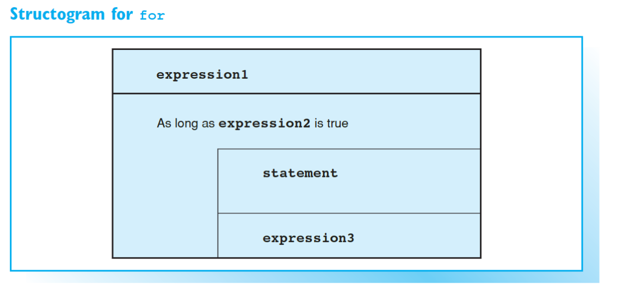
The for statement

Slide 7

Initializing and Reinitializing
A typical loop uses a counter that is initialized, tested by the controlling expression and reinitialized at the end of the loop.
EXAMPLE
Any expression can be used to initialize and reinitialize the loop. Thus, a for loop has the following form:
Expression1 is executed first and only once to initialize the loop. Expression2 isthe controlling expression, which is always evaluated prior to executing the loop body:
If expression2 is false, the loop is terminated
If expression2 is true, the loop body is executed. Subsequently, the loop is reinitialized by executing expression3 and expression2 is re-tested.

Slide 8
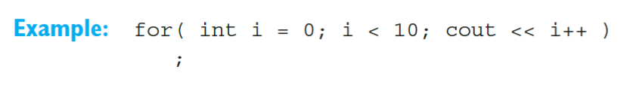
INITIALIZING AND REINITIALIZING
You can also define the loop counter in expression1. Doing so means that the counter can be used within the loop, but not after leaving the loop.
As this example illustrates, the loop body can be an empty statement. This is always the case if the loop header contains all necessary statements. However, to improve readability, even the empty statement should occupy a line of its own.

Slide 9

INITIALIZING AND REINITIALIZING
Any of the three expressions in a for statement can be omitted, however, you must type at least two semicolons. The shortest loop header is therefore:
This statement causes an infinite loop, since the controlling expression is assumed to be true if expression2 is missing

Slide 10
The Comma Operator
You can use the comma operator to include several expressions where a single expression is syntactically correct. For example, several variables can be initialized in the loop header of a for statement.
The expressions separated by commas are evaluated from left to right.
EXAMPLE
The comma operator separates the assignments for the variables I and limit and is then used to calculate and output the value of x in a single statement. The comma operator has the lowest precedence of all operators — even lower than the assignment operators. This means you can leave out the parentheses in the above example. Like any other C++ expression, an expression containing the comma operator has a value and belongs to a certain type. The type and value are defined by the last expression in a statement separated by commas.
EXAMPLE
In this example the statements in brackets are executed before the value of the product of a * b is assigned to x.

Slide 11
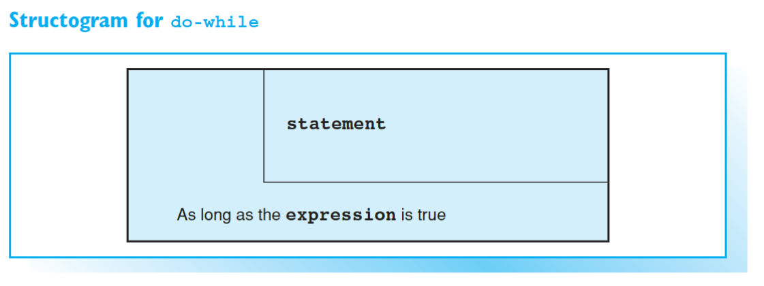
THE do-while STATEMENT
In contrast to while and for loops, which are controlled by their headers, the do-while loop is controlled by its footer, i.e. the controlling expression is evaluated after executing the first loop. This results in the loop body being performed at least once.

Slide 12
Nesting loops
Loops can be nested, that is, the loop body can also contain a loop. The ANSI standard stipulates a maximum depth of 256 nested loops.
The EXAMPLE outputs a number of tones with the number being defined by user input. The program contains two loops — one of which is nested in the other. Each time the outer do-while loop is repeated a short break occurs. The break is caused by the inner for loop where the variable I is incremented from 0 to the value of delay. Text and a tone are subsequently output. The tone is generated by outputting the control character BELL (ASCII code 7), which is represented by the escape sequence \a. Since a do-while statement is used, the program outputs a tone even if the user types 0 or a negative number.

Slide 13
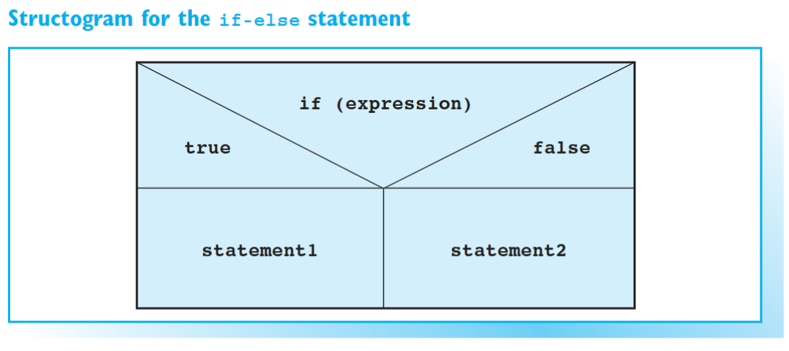
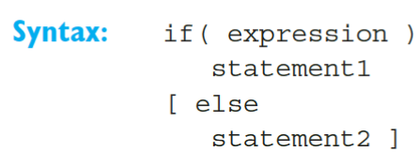
Selections with if-else
The if-else statement can be used to choose between two conditional statements.
When the program is run, expression is first evaluated and the program control branches accordingly. If the result is true,statement1is executed and statement2 is executed in all other cases, provided an else branch exists. If there is no else and expression is false, the control jumps to the statement following the if statement.

Slide 14
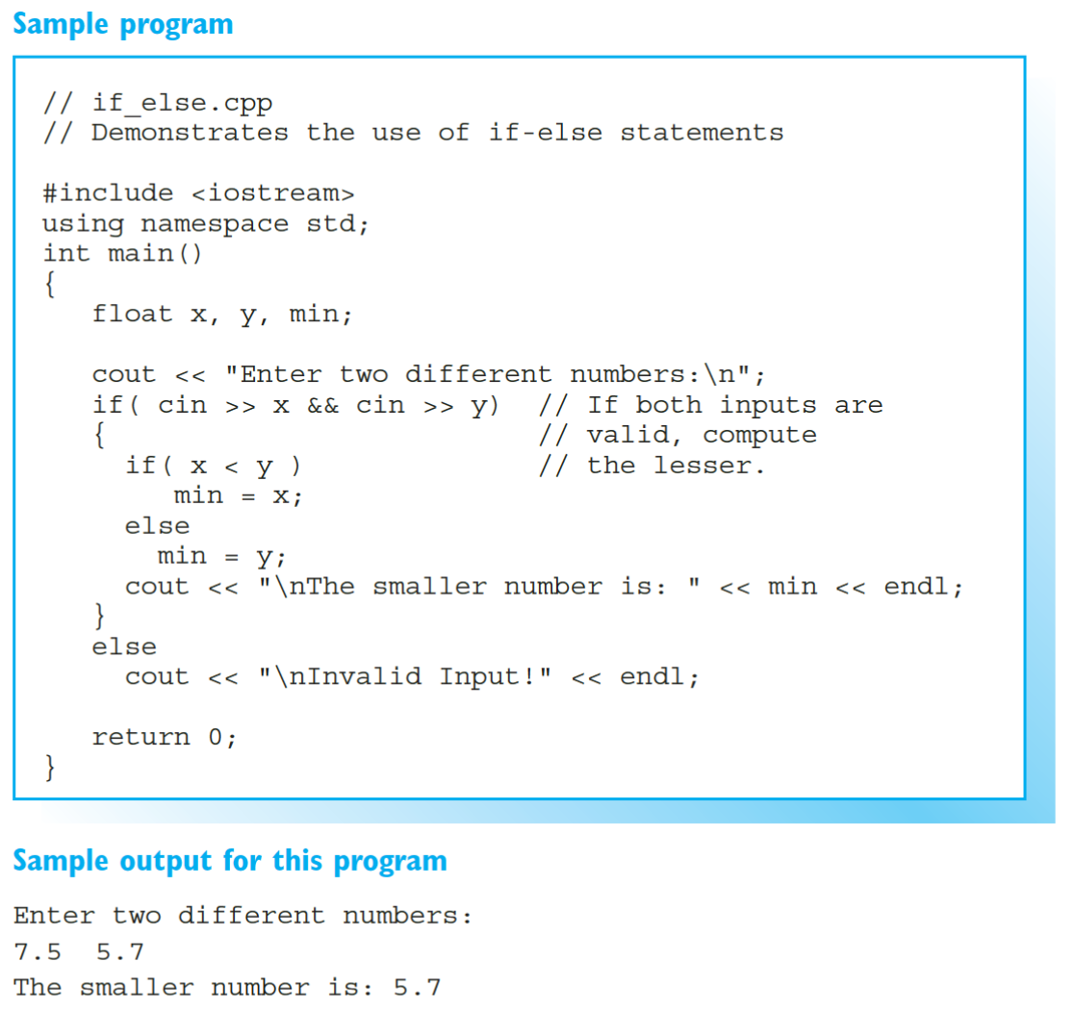
Nested if-else Statements
As the program illustrates, multiple if-else statements can be nested. But not every if statement has an else branch. To solve the resulting problem, an else branch is always associated with the nearest preceding if statement that does not have an else branch.

Slide 15
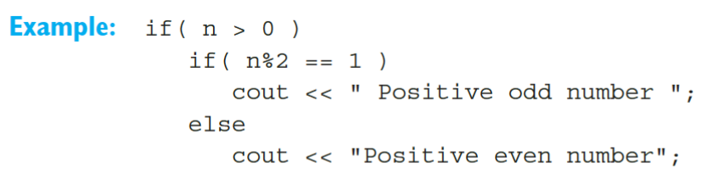
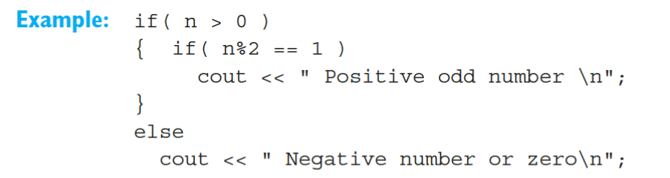
NESTED IF-ELSE STATEMENTS
In this example, the else branch belongs to the second if, as is indicated by the fact that the statement has been indented.
However, you can use a code block to redefine the association of an else branch.

Slide 16
Defining Variables in if Statements
You can define and initialize a variable within an if statement. The expression is true if converting the variable’s value to a bool type yields true. In this case the variable is available within the if statement.
The return value of the function, func(), is used to initialize the variable x. If this value is not 0, the statements in the next block are executed. The variable x no longer exists after leaving the if statement.

Slide 17
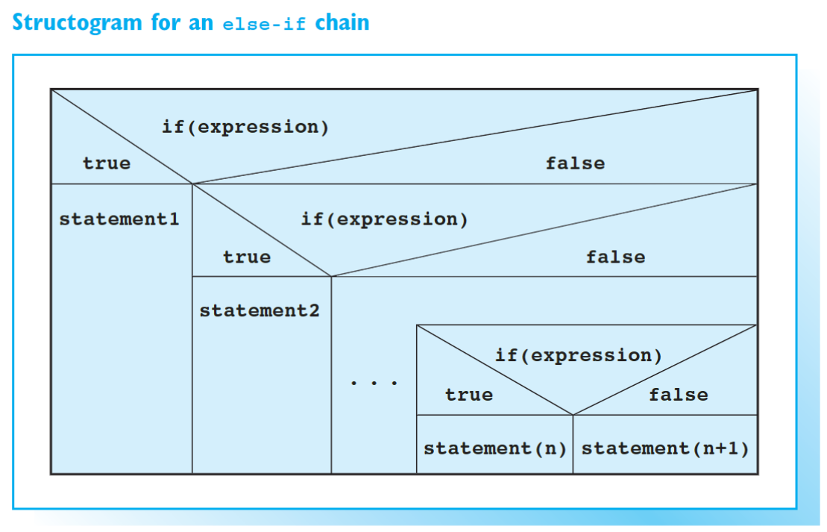
Else-if CHAINS

Slide 18
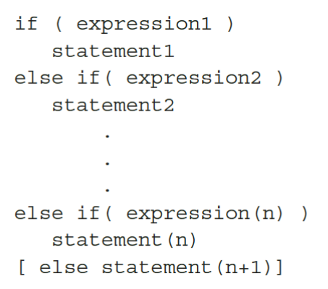
Layout and Program Flow
You can use an else-if chain to selectively execute one of several options. An else-if chain implies a series of embedded if-else statements whose layout is normally as follows:
When the else-if chain is executed, expression1,expression2,...are evaluated in the order in which they occur. If one of the expressions proves to be true, the corresponding statement is executed and this terminates the else-if chain. If none of the expressions are true, the else branch of the last if statement is executed. If this else branch is omitted, the program executes the statement following the else-ifchain.

Slide 19
EXAMPLE
The EXAMPLE uses an else-if chain to evaluate the penalty for driving too fast and outputs the fine on screen. The speed limit and the actual speed are read from the keyboard. If the user types 60 as the speed limit and 97.5 as the actual speed, the first three expressions are not true, and the last else branch is executed. This outputs the message "Hand over your driver's license!" on a new line.

Slide 20
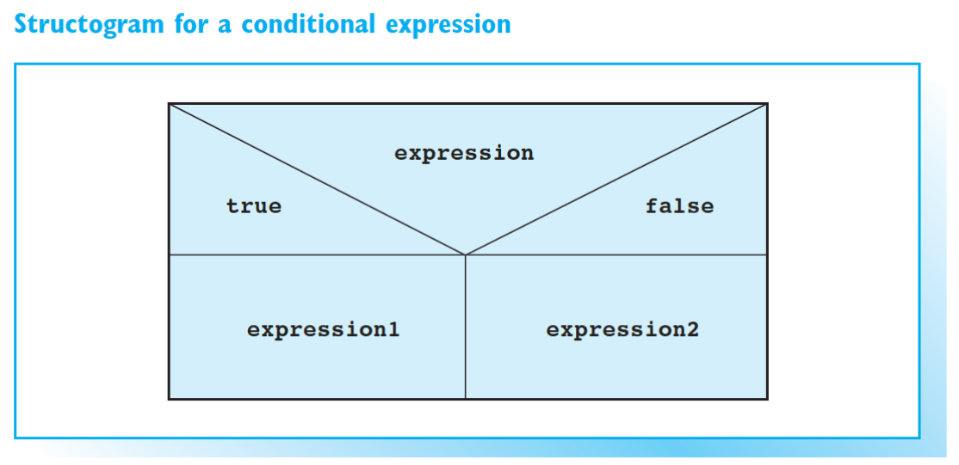
Conditional expressions

Slide 21
Conditional operator
The conditional operator ?: is used to form an expression that produces either of two values, depending on the value of some condition. Because the value produced by such an expression depends on the value of a condition, it is called conditional expression. In contrast to the if-else statement the selection mechanism is based on expressions: one of two possible expressions is selected. Thus, a conditional expression is often a concise alternative to an if-else statement.
Expression is evaluated first. If the result is true, expression1 is evaluated; if not expression2 is executed. The value of the conditional expression is therefore either the value of expression1 or expression2.

Slide 22

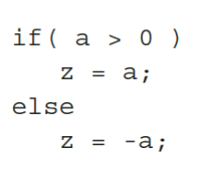
CONDITIONAL OPERATOR
This statement assigns the absolute value of a to the variable z. If a has a positive value of 12, the number 12 is assigned to z. But if a has a negative value, for example –8, the number 8 is assigned to z.
Since this sample program stores the value of the conditional expression in the variable z, the statement is equivalent to
.

Slide 23
Precedence
The conditional operator is the only C++ operator with three operands. Its precedence is higher than that of the comma and assignment operators but lower than all other operators. In other words, you could omit the brackets in the first example.
EXAMPLE
You can use the result of a conditional evaluation without assigning it, as the EXAMPLE shows. In this example, x is printed on screen if x is greater than y, and y is printed otherwise. However, you should assign the result of complex expressions to a variable explicitly to improve the readability of your program.

Slide 24
exercises
Homework 2:
Write a C++ program that reads an integer between 0 and 65535 from the keyboard and uses it to seed a random number generator. Then output 20 random numbers between 1 and 100 on screen (Due next class)
HINTS:
Use the user's seed input by utilizing <stdlib.h> and srand(seed)
Utilize a for loop to generate the 20 numbers (or a while loop, whichever works for you better)
Create an output that will print out a statement for each random number
Random number 1:
Random number 2:
And so on...

Slide 25
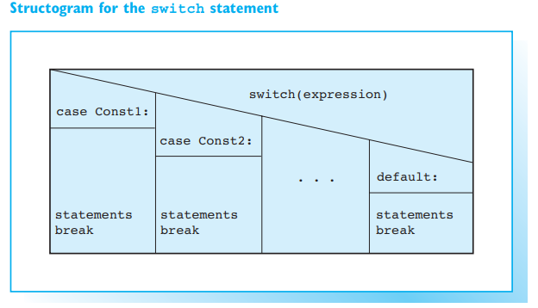
Selecting with switch
Just like the else-if chain, the switch statement allows you to choose between multiple alternatives. The switch statement compares the value of one expression with multiple constants.
EXAMPLE: Evaluating the given input

Slide 26
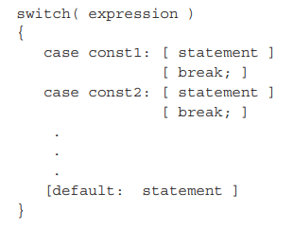
The switch statement
First, the expression in the switch statement is evaluated. It must be an integral type. The result is then compared to the constants, const1, const2, ..., in the case labels. The constants must be different and can only be integral types (boolean values and character constants are also integral types).
If the value of an expression matches one of the case constants, the program branches to the appropriate case label. The program then continues and the case labels lose their significance.
You can use break to leave the switch statement unconditionally. The statement is necessary to avoid executing the statements contained in any case labels that follow.
If the value of the expression does not match any of the case constants, the program branches to the default label, if available. If you do not define a default label, nothing happens. The default does not need to be the last label; it can be followed by additional case labels.

Slide 27
Differences between switch and else-if Chains
The else-if chain is more versatile than the switch statement. Every selection can be programmed using an else-if chain. But you will frequently need to compare the value of an integral expression with a series of possible values. In this case (and only this case), you can use a switch statement.
As the EXAMPLE shows, a switch statement is more easily read than an equivalent else-if chain, so use the switch statement whenever possible.

Slide 28
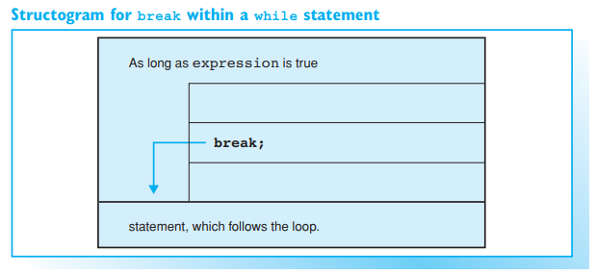
Jumps with break, continue, and goto

Slide 29
JUMPS WITH BREAK, CONTINUE, AND GOTO
The break statement exits from a switch or loop immediately. You can use the break keyword to jump to the first statement that follows the switch or loop.
EXAMPLE: Output an ASCII Code table
The EXAMPLE, which outputs a group of 20 ASCII characters and their corresponding codes, uses the break keyword in two places. The first break exits from an infinite while(true) { ... } loop when a maximum value of 256 has been reached. But the user can also opt to continue or terminate the program. The second break statement is used to terminate the while loop and hence the program.

Slide 30
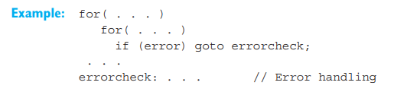
JUMPS WITH BREAK, CONTINUE, AND GOTO
C++ also offers a goto statement and labels. This allows you to jump to any given point marked by a label within a function. For example, you can exit from a deeply embedded loop construction immediately
A label is a name followed by a colon. Labels can precede any statement. Any program can do without goto statements. If you need to use a goto statement, do so to exit from a code block, but avoid entering code blocks by this method.

Slide 31
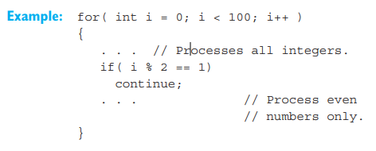
JUMPS WITH BREAK, CONTINUE, AND GOTO
The continue statement can be used in loops and has the opposite effect to break, that is, the next loop is begun immediately. In the case of a while or do-while loop the program jumps to the test expression, whereas a for loop is reinitialized.

